Slide 2
Yvette Myer
Old Republic Home Protection

Slide 3
Old Republic Home Protection
2-10 Home Buyers Warranty
Fidelity Home Warranty
Fairway with Bookspan Baker Team
Liberty Inspections
Fidelity National Title Agency
Magnus Title ETA
Security Title Agency

Slide 5
NEEDS & WANTS

Slide 7
EXTREME TIME MANAGEMENT
FOR RELENTLESS RESULTS
Short link…
https://goo.gl/qL2ysw
Get out your phones and register NOW!!!
ADAM HERGENROTHER
Mon, Oct 23rd
9am – 4pm
AZ Heritage Center at Papago Park

Slide 8
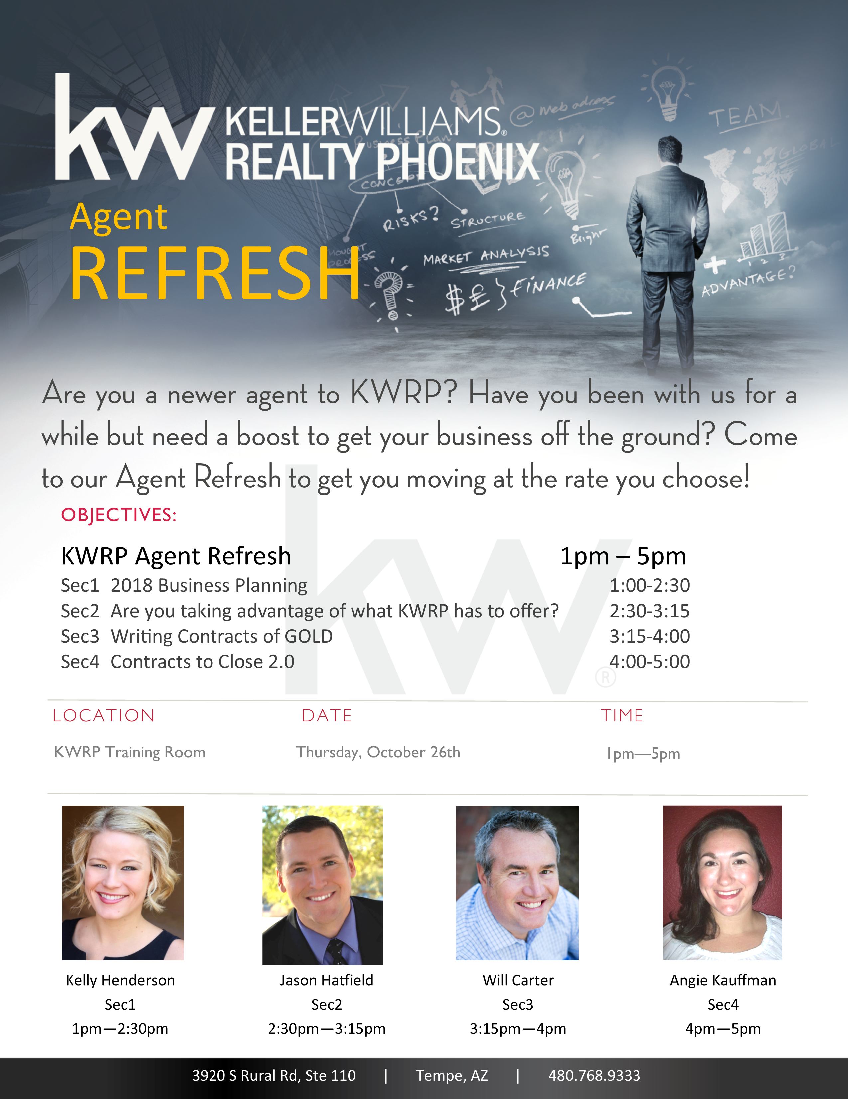
Bring your laptop!!

Slide 9
Thu, Nov 2nd 1-4
Happy Hour to Follow

Slide 10
Holiday Office Door Decorating Contest
Ready!
Set!!
Decorate!!!
Nov 17th: Start decorating those doors!
Dec 14th: Voting for Best Door Décor
Bring your Competitive Holiday Spirit!

Slide 11
Celebrate The Holiday Season with your
KWRP Family.
We invite you to join us for appetizers, drinks and dessert!
TO
December 1st, 2017 6:30-10:30 PM

Slide 12
THU, DEC 14TH AT 1PM

Slide 13
Wait for it…

Slide 14
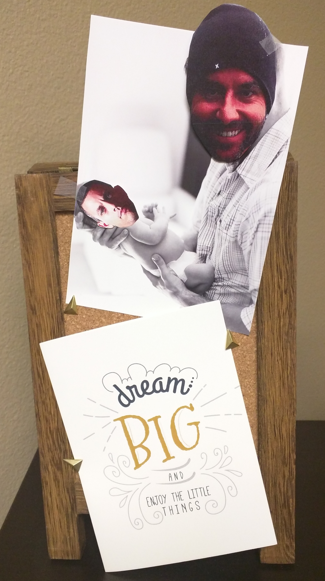
You can’t unsee that!

Slide 18
Bethanie Madewell
October

Slide 19
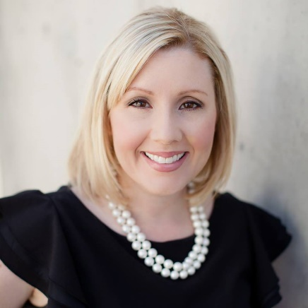
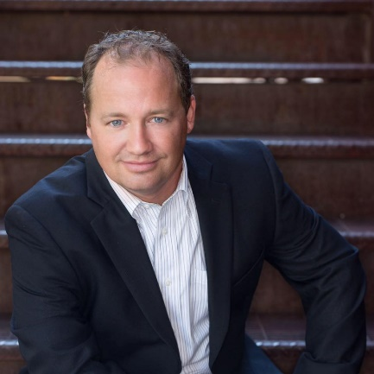
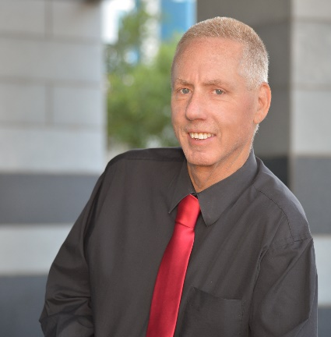
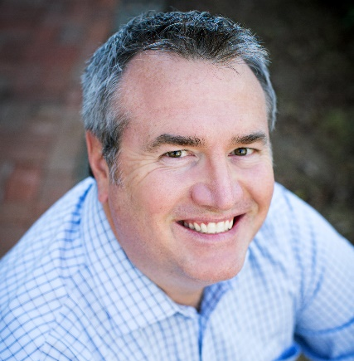
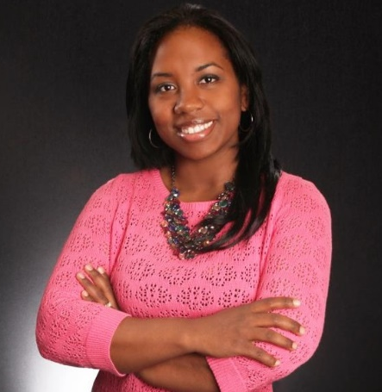
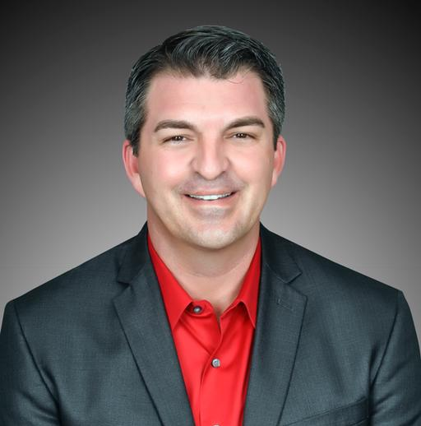
Thank you…
2017 Associate Leadership Council
Emily Duarte
Nathan Biggar
Arnold Bedak
Will Carter
Caroline Torres
Ty Lusk

Slide 20
WELCOME
OUR NEW ASSOCIATES
15
Austen Oakley
Chad Utt
Julio Rodriguez
Christopher Michel
Thomas Devor
Danielle Devor
LeRoy Romero
Stephanie Vogel
Josh Naylor
Jason Hatfield
Tessandra Sheridan
Allison Brooks
Katie Callahan
William Wilson
Lindsey Blazevich

Slide 21
Amount Given Year To Date
$12,597
KW Cares is a 501(c)(3) public charity created to support Keller Williams
associates and their families with hardship as a result of a sudden emergency.

Slide 22
Amount Of Profit Shared Year To Date
$137,830

Slide 23
Caleb Richards
Leonard Edge
Lina Morales
Richard Mendoza
L
C

Slide 24
Brad Giesinger Michael Menifee
Ty Lusk Daniela Virani

Slide 26
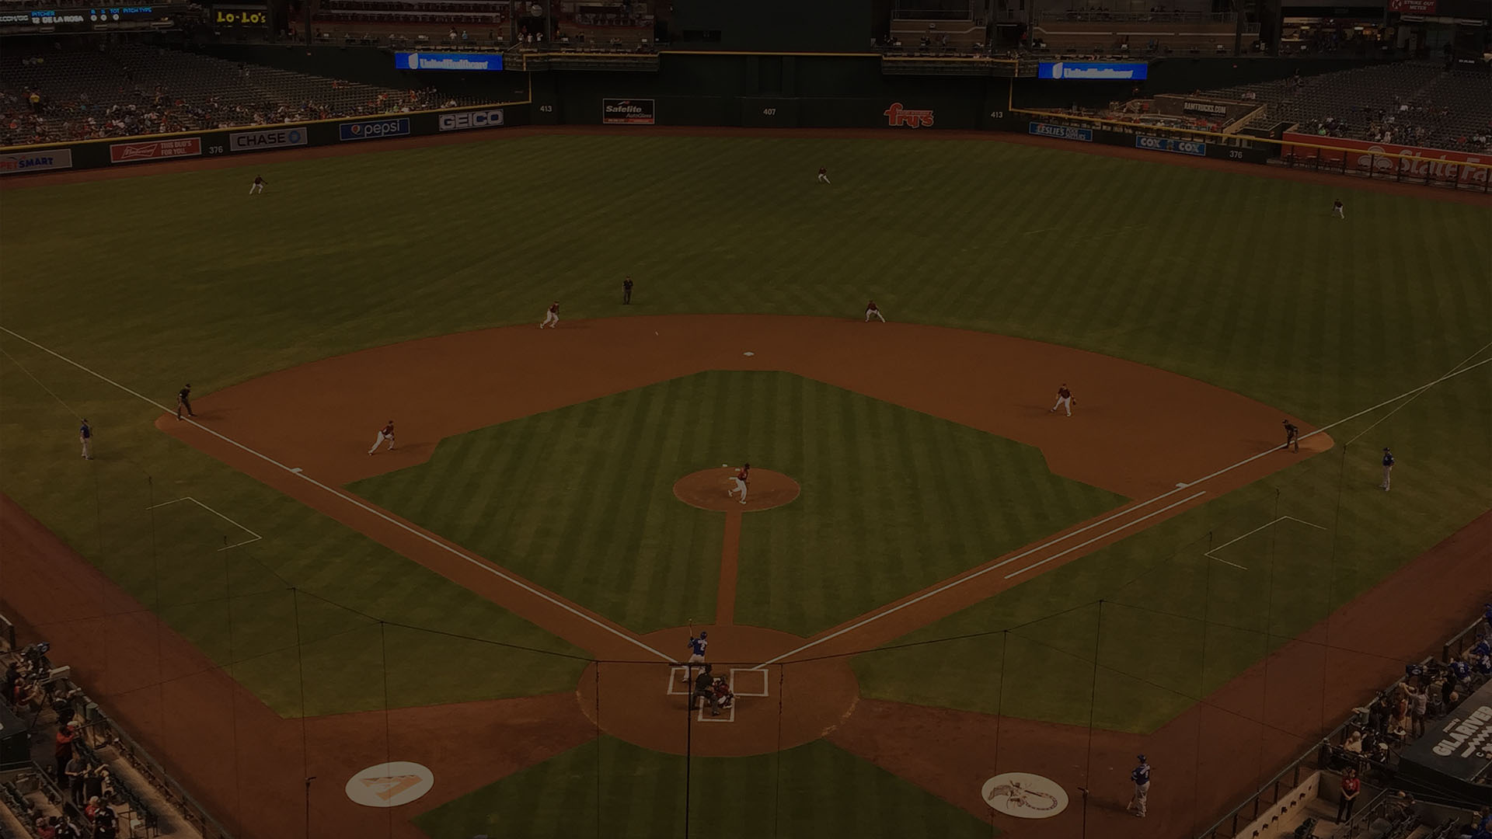
Homeruns
1 listing taken, 1 contract written, and 1 contract closed in 1 month
Andrea Romero
Anne Svoboda
Bethanie Madewell
Brett Tanner
Brian Gubernick
Carin Nguyen
Carlie Back
Carlie Goulet
Carolyn Karlovsky
Casey Cuppy
Chris Illgen
Douglas Brinton
Eric Avdee
Frank Vasquez
Fred Weaver
Geoffrey Jablonski
Isaac Kahn
Jael Valdez
James Sanson
Jose Torres
Josh Asanovich
Kelly Henderson
Kevin Kauffman
Marilee Roberge
Marshall Hancock
Michelle Colbert
Nic McMurry
Steve Horn
Ty Lusk

Slide 27
Closed Volume: Top Agents
Sept 2017
Kimberly Elias $926,000
IKAHN Property & Investment $795,000
Angela Larson $764,000
Marilee Roberge $734,150
Marshall Hancock Team $651,500
CC & Co Real Estate Team $647,000
Mike Menefee $523,000
Nic McMurray $402,000

Slide 28
Closed Volume: Top Teams
Sept 2017
The Torres Group $641,400
GAMETIME $607,033
Better Desert Living Partners $574,000

Slide 29
Closed Volume: Top Groups
Sept 2017
Carin Nguyen Team $4,102,885
Movement Home Team $3,806,585
Smart Concept Realty Group $3,412,050
The Brett Tanner Team $2,883,450
Jablonski Real Estate Group $2,544,739
Momentum Real Estate Group $2,182,990
Group 46:10 $2,049,800
Lux Home Group $1,857,500
Homehelper Consultants $1,815,890
The Carlie Back Team $1,249,382

Slide 30
DOUBLE TAKE
YOY Growth
Joseph Cochell Sean Pieper
Michael Burk Jackie Nedin
Krista Anspach Kay Shepard
Marilee Roberge Jose Torres
Bethanie Madewell
Robert Habeeb David Casey
Ryan Loeding Cody Goodman
Julie Chamberlain Aaron Dutcher
Kelly Bridges Marvin Green

Slide 31
Monthly Spirit Award

Slide 32
Monthly Spirit Award
Jael Valdez

