Slide 2
Yvette Myer
Old Republic Home Protection

Slide 3
Old Republic Home Protection
2-10 Home Buyers Warranty
Fidelity Home Warranty
Fairway with Bookspan Baker Team
Liberty Inspections
Fidelity National Title Agency
Magnus Title ETA
Grand Canyon Title Agency

Slide 4
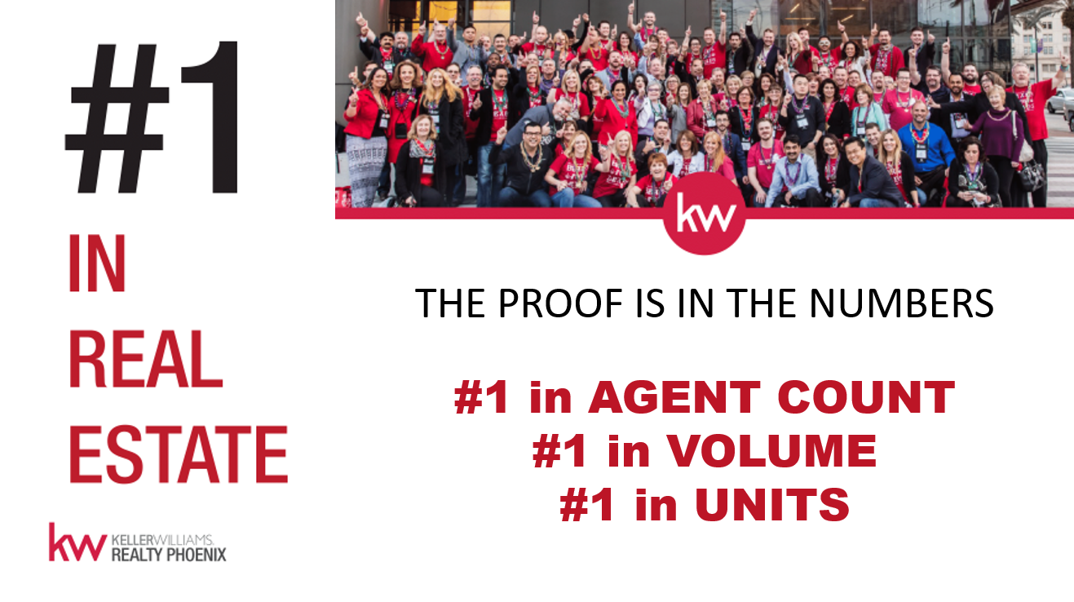

Slide 13
Upcoming Classes
Tue, Feb 27th
New Agent Orientation 2pm
Contracts 101 3pm
How to Get Paid
Greensheets & SkySlope 4pm
Fri, March 9th
New Agent Orientation 9am
How to Get Paid
Greensheets & SkySlope 10am
BoomTown 11am
Bring your laptop!

Slide 14
TITLE TIME
WITH FIDELITY, MAGNUS AND GRAND CANYON

Slide 15
NEEDS & WANTS

Slide 16
THE 2017 BEST IN REAL ESTATE AWARDS
Brett Tanner - Top Producing REALTOR Recipient
Keller Williams Realty Phoenix - Top Producing Brokerage
(100-250 REALTOR category)
CONGRATULATIONS!

Slide 18
WELCOME
OUR NEW ASSOCIATES
Joshua Brewer
Kyle Duane
Jesse Heimann
Robert Lorenz
Patrick Madrid
Maria Mutamiri
Ryan Rush
Pedro Soqui
Brett Zieske
9

Slide 19
Amount Given Year To Date
$1,172
KW Cares is a 501(c)(3) public charity created to support Keller Williams
associates and their families with hardship as a result of a sudden emergency.

Slide 20
Amount Of Profit Shared Year To Date
$8,404.98

Slide 21
FIRST LISTING
FIRST CLOSING
Kendra Russell
Amy Ledbetter
Jeremy Rodriguez
Kristi Ann Adams
Nicholas Kibby
Rob Swanson
Timothy Copley

Slide 22
Associates Who Capped
Emily Duarte
Isaac Kahn
Alex Mogo
Jose Torres
100%

Slide 24
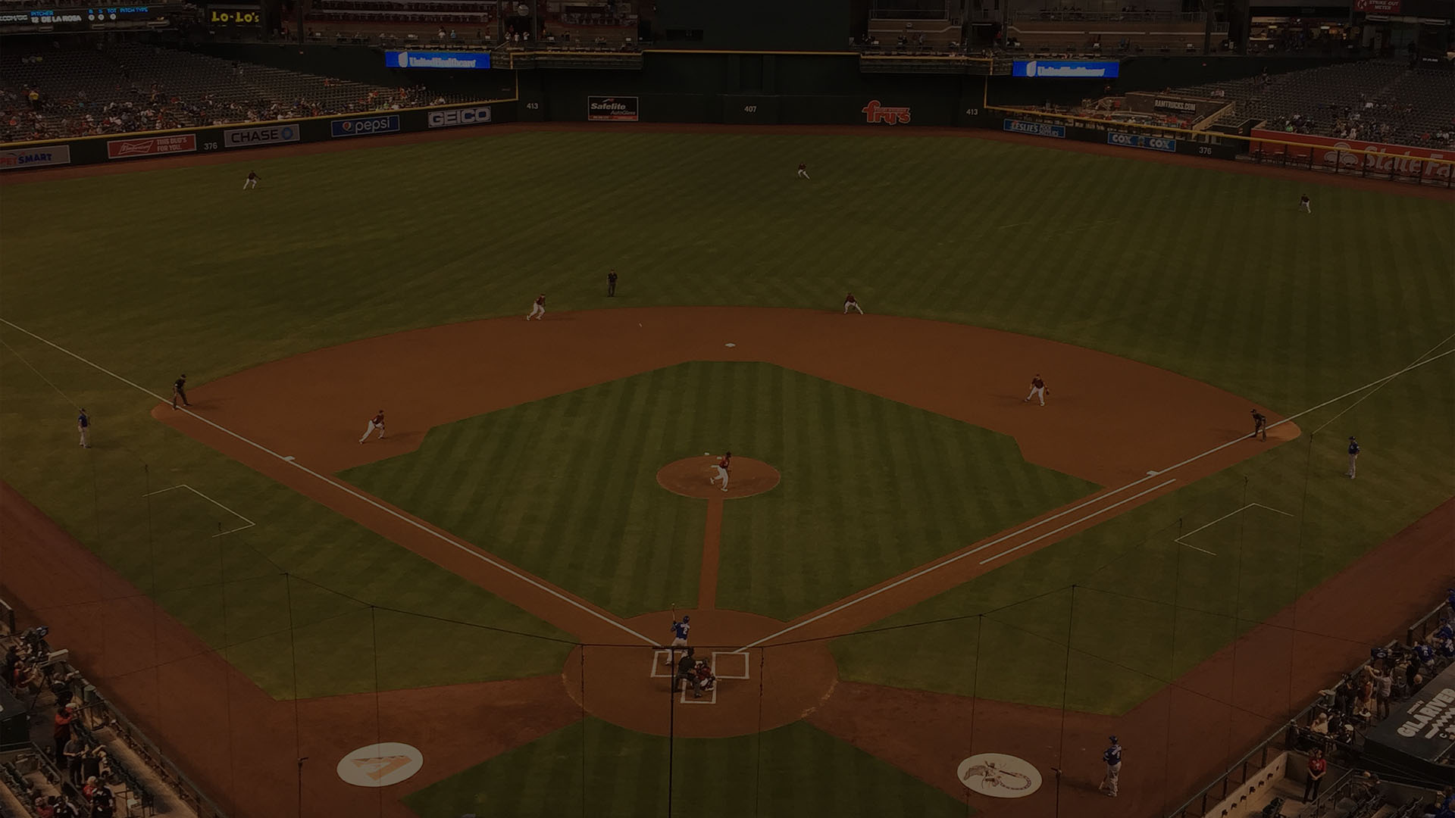
Homeruns
1 listing taken, 1 contract written, and 1 contract closed in 1 month
Amy Ledbetter
Angela Larson
Brett Tanner
Brian Gubernick
Carin Nguyen
Carlie Back
Carlie Goulet
Cody Goodman
Cristen Corupe
Debbie Hayes
Emily Duarte
Eric Avdee
Frank Vasquez
Fred Weaver
Geoffrey Jablonski
Jackie Nedin
James Sanson
Josh Asanovich
Kelly Henderson
Kerry Loeding
Mike Menefee
Samantha Allen

Slide 25
Closed Volume: Top Agents
Jan 2018
Will Carter $1,701,500
Angela Larson $1,612,495
Mike Menefee $1,342,650
Marvin Green $972,804
Chris Illgen $925,400
Kimberly Elias $858,000
Andrea Juarez $624,500
Amy Ledbetter $609,950
Debbie Hayes $594,900
Duane Louton $569,900

Slide 26
Closed Volume: Top Teams
Jan 2018
The Torres Group $816,500
The Devor Team $639,340

Slide 27
Closed Volume: Top Groups
Jan 2018
Lux Home Group $4,101,915
Carin Nguyen Team $3,562,335
Homehelper Consultants $1,974,330
Brett Tanner Home Selling Team $1,886,920
The Valley Group $1,789,340
The Steve Horn Team $1,706,050
Movement Home Team $1,604,800
Real Estate Rock Stars $1,603,950
Smart Concept Realty Group $1,397,000
The Carlie Back Team $1,326,000

Slide 28
KWRP VS ARMLS
MONTH OVER MONTH
C A T E G O R Y
Producing Agents
Closed Production – List
Closed Production – Sell
Closed Production - Total
K W R P
20.78%
15.3%
25.27%
20.06%
A R M L S
-9.99%
-11.9%
-11.99%
-11.99%

Slide 29
Monthly Spirit Award

Slide 30
Monthly Spirit Award
Dina Bedak

