Slide 2
Todd Marcell
2-10 Home Buyers Warranty

Slide 3
2-10 Home Buyers Warranty
Old Republic Home Protection
Fidelity Home Warranty
Fairway with Bookspan Baker Team
Fidelity National Title Agency
Magnus Title ETA
Grand Canyon Title Agency

Slide 7
36:12:3
36 CLOSED TRANSACTIONS
IN 12 MONTHS
WITH 3 HOURS A DAY
M | W | F
1-4

Slide 10
Upcoming Classes
Tue, March 27th
New Agent Orientation 2pm
Contracts 101 3pm
How to Get Paid
Greensheets & SkySlope 4pm
Fri, April 13th
How to Get Paid
Greensheets & SkySlope 9am
New Agent Orientation 10am
Fri, April 20th
BoomTown 11am
Bring your laptop!

Slide 11
KWRP Culture Committee Endorsed Events
International Friendship Potluck
Thu, March 22nd at 12pm
Regional Spring Fling Picnic
Sat, Mar 24th at 2pm
Agents Benefitting Children
Friday, April 13th
Register for all of these events and more at phxkw.com/events

Slide 15
First Step: Wed, March 28th
Register at phxkw.com/events

Slide 16
TITLE TIME
WITH FIDELITY, MAGNUS AND GRAND CANYON

Slide 18
WELCOME
OUR NEW ASSOCIATES
Jonathan Benninger
Mathew Bets
Lisa Bowen
Jerry Brandvig
Laney Crowley
Alicia Davis
Ronnie Edge Jr
Valerie Denise Falkner
Mitchell Hannah
Kimberly Lamb
Nick Longmire
Deborah McLean
Stacie Mitchell-Gweah
Nir Nachum
Kyle Olson
Julia SalAs
Christopher Sutter
Heather Velasco
Aaron Waters
19

Slide 19
Amount Given Year To Date
$1,680
KW Cares is a 501(c)(3) public charity created to support Keller Williams
associates and their families with hardship as a result of a sudden emergency.

Slide 20
Amount Of Profit Shared Year To Date
$13,793.33
We’d like to recognize…

Slide 22
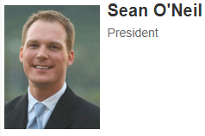

Slide 23
FIRST LISTING
FIRST CLOSING
Nicholas Kibby
Cylie Ann Lawrence
Michelle Selzler
Sheila Rose

Slide 24
Associates Who Capped
Wesley Bender
Geoffrey Jablonski
Skyler Keyser
Angela Larson
Michael Menefee
Matthew Pagnozzi
100%

Slide 26
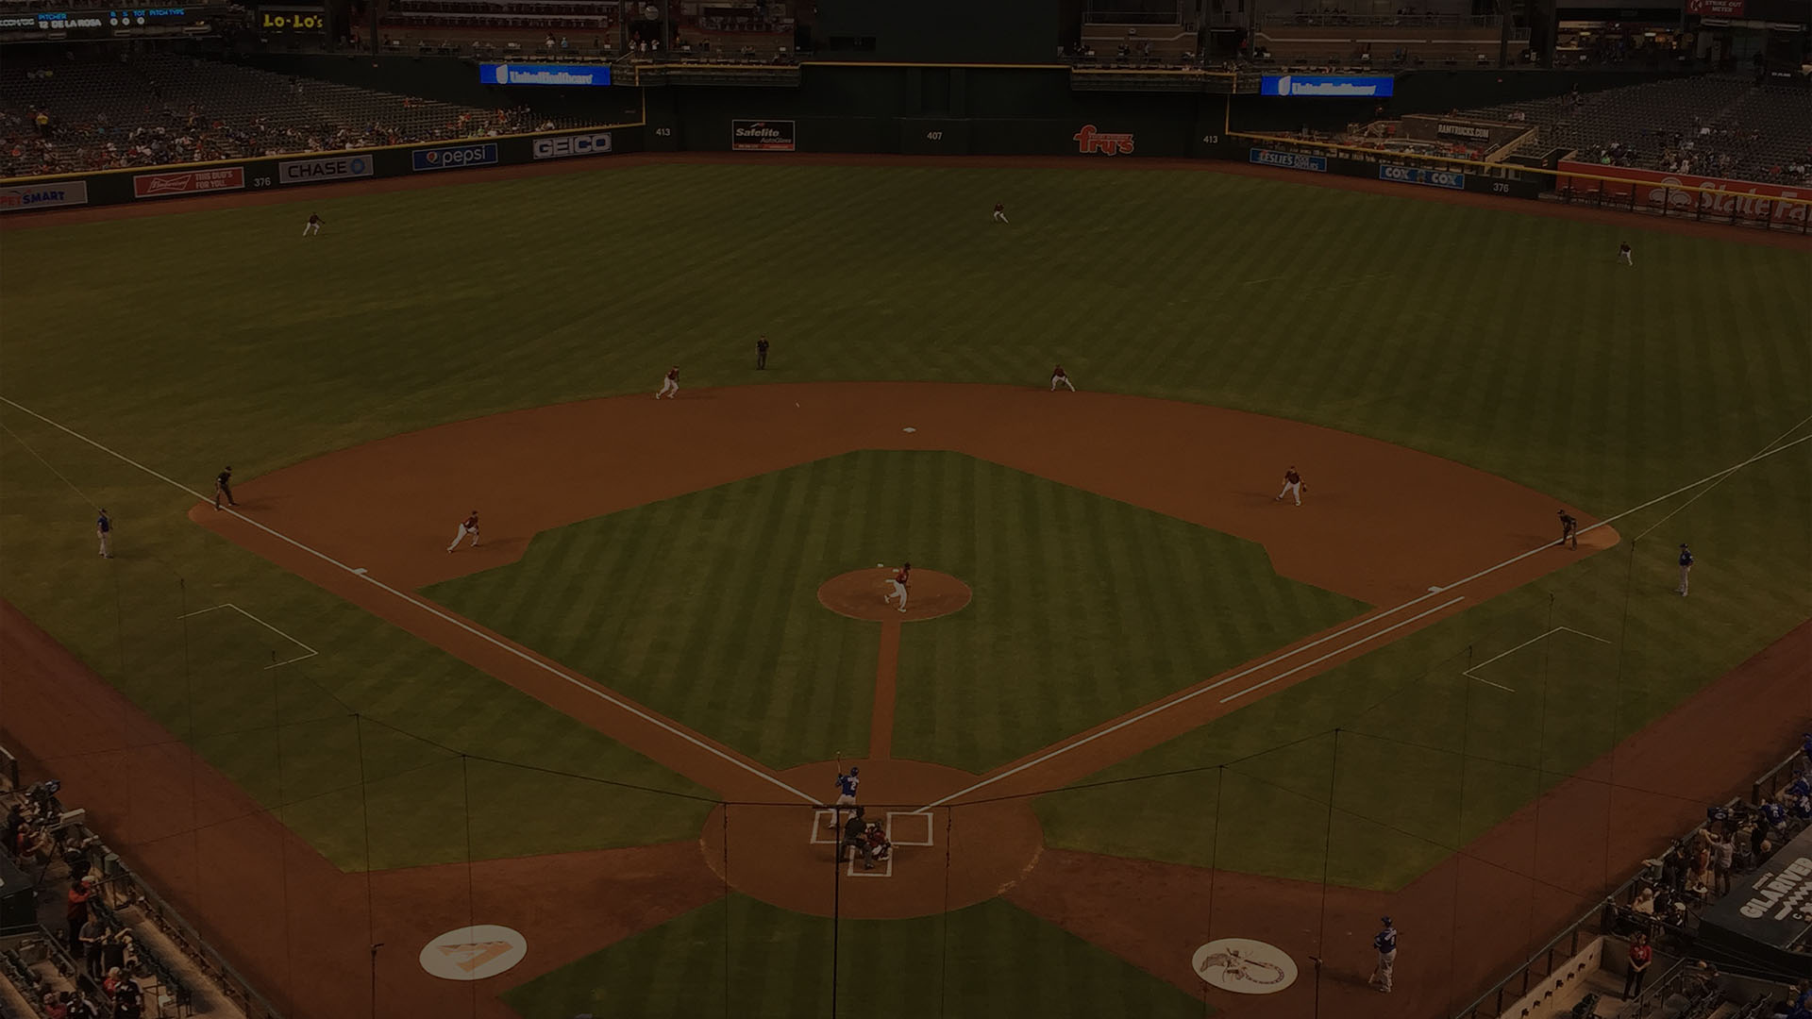
Homeruns
1 listing taken, 1 contract written, and 1 contract closed in 1 month
Angela Larson
Anne Svoboda
Arlene Day
Brett Tanner
Brian Gubernick
Brian Thompson
Carin Nguyen
Carlie Goulet
Chris Illgen
Cristen Corupe
Emily Duarte
Erik Kelly
Frank Vasquez
Fred Weaver
James Sanson
Josh Asanovich
Kelly Henderson
Kimberly Elias
Nathan Biggar
Steve Horn
Thomas Devor
Tyler Truscio

Slide 27
Closed Volume: Top Agents
Feb 2018
Angela Larson $1,641,500
Will Carter $970,500
Marilee Roberge $677,400
Chris Illgen $633,900
Mike Menefee $531,500
Matt Rogers $430,000

Slide 28
Closed Volume: Top Teams
Feb 2018
Better Desert Living Partners $1,110,208
The Devor Team $615,200
Truscio Group $542,000
Erik Kelly Group $465,000

Slide 29
Closed Volume: Top Groups
Feb 2018
Homehelper Consultants $5,760,374
The Brett Tanner Team $4,452,400
Carin Nguyen Team $3,991,348
Lux Home Group $3,072,100
Smart Concept Realty Group $2,348,681
The Carlie Back Team $2,348,212
Group 46:10 $2,253,280
The Steve Horn Team $2,208,955
Jablonski Real Estate Group $1,983,790
The Valley Group $1,660,700

Slide 30
Monthly Spirit Award

